Slide 1
BITCOIN MARKET PRICE PREDICTION
BY
Divya Jayaprakash

Slide 2
WHAT IS A BITCOIN
Bitcoin was established in 2009 by Satoshi Nakamoto
It is a cryptocurrency and worldwide payment system
It is the first decentralized digital currency
Can be used for online transactions between individuals
Created as a reward for a process known as mining

Slide 3
BITCOIN PRICE FLUCTUATION
Just like most currencies, the price of Bitcoin changes every day
Bitcoin’s value is based on how valuable the market thinks it is
Bitcoin price change is similar to the example of gold
Predicting bitcoin prices is critical for investors

Slide 4
DATASET OVERVIEW
Training dataset – bitcoin_dataset.csv
Dataset consists of 2907 rows and 24 columns
Target variable - btc_market_price
Test dataset – test_set.csv

Slide 5
DATA ANALYSIS PROCESS
Data Exploration
Data Imputation & Cleaning
Building different regression models
Comparing the models to find the best predictor

Slide 6
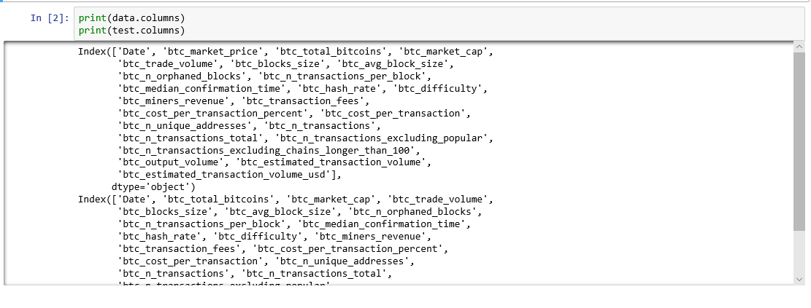
Data Exploration

Slide 7
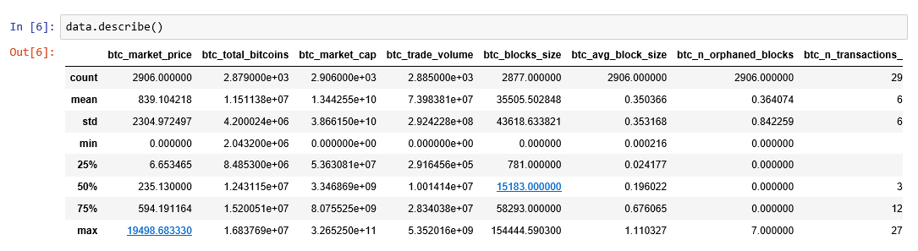

Slide 8
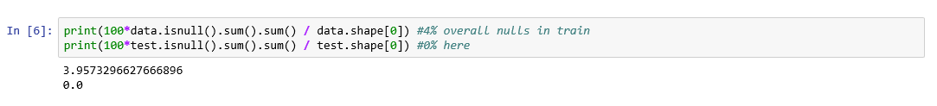
Finding Missing data
Check the percentage of missing values in training & test data

Slide 9
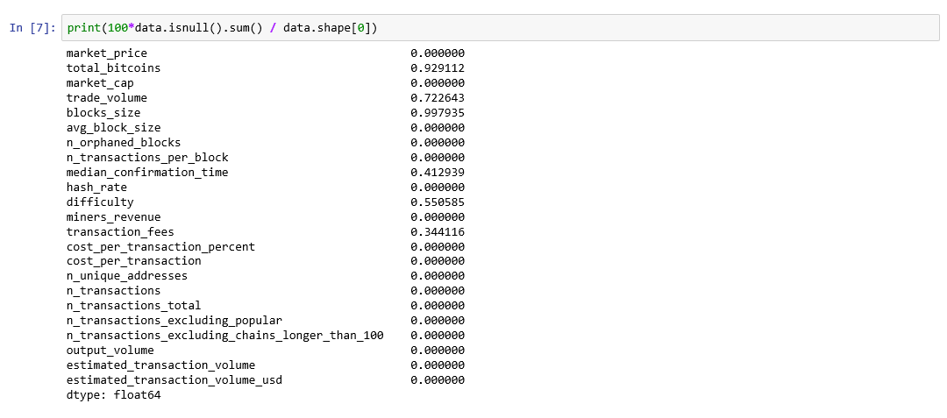
Printing the percentage of missing values in each column

Slide 10
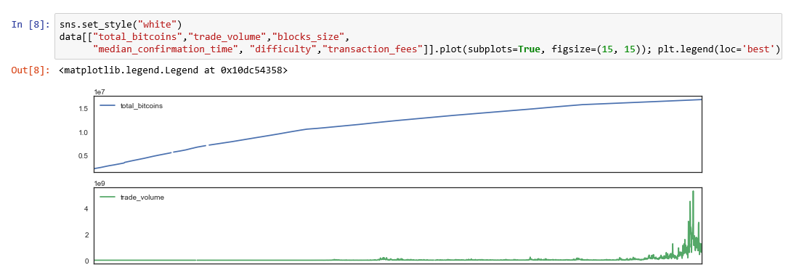
Plot the missing values to see the pattern and decide on how to impute

Slide 11
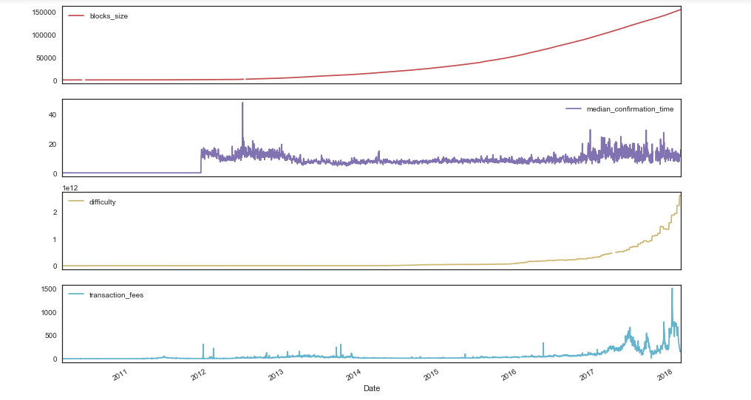

Slide 12
The ColsToImpute below has features with mostly a linear trend near the missing values
So, we are using a linear interpolation method with time to impute them
After this, only the median_confirmation_time column will have missing values
It is reasonable to fill them using the mean value because it has most of it's values 0 and 47 with mean around 7.5

Slide 13
Splitting the data into dependent and independent variables
Split into training and test dataset

Slide 14
We are using scaled data to run most of our models for better computation and convergence

Slide 15
Model Building
1. KNN Regressor
Run the KNN Regressor for K from 1 to 19
For K = 2 we are getting the best test accuracy
The train accuracy is 0.9979 and test accuracy is 0.9944

Slide 16
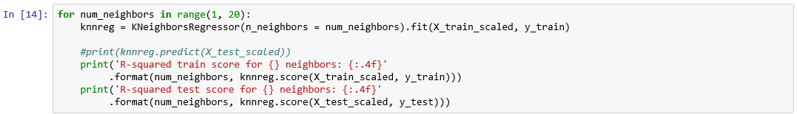
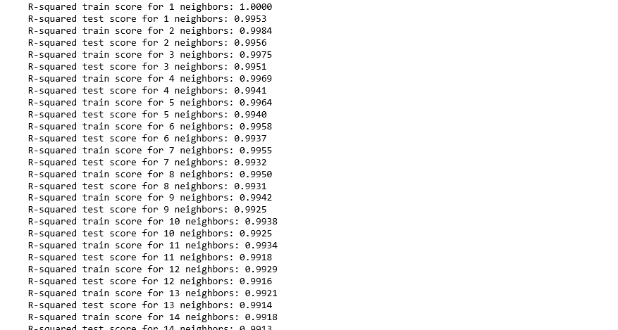

Slide 17
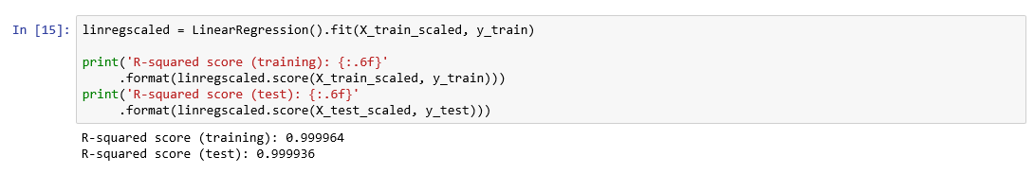
2. Linear Regression
While performing linear regression the train accuracy is 0.999964 and test accuracy is 0.999936
As we can see that Linear Regression performs better we will not consider KNN for further analysis.

Slide 18
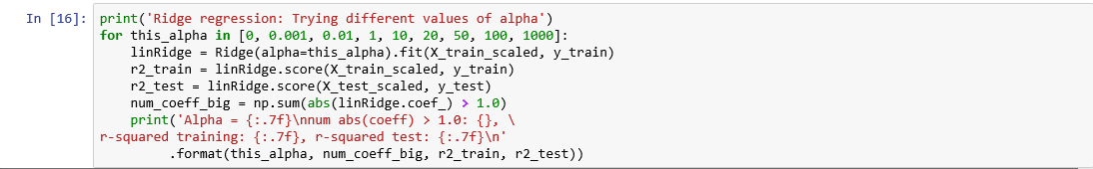
3. Ridge Regression
Next, we try Ridge regression with different values of alpha.
This seems to perform good with very low values of alpha

Slide 19
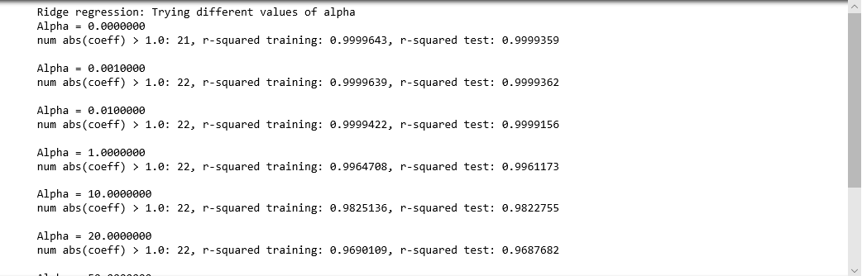
Ridge regression output:

Slide 20
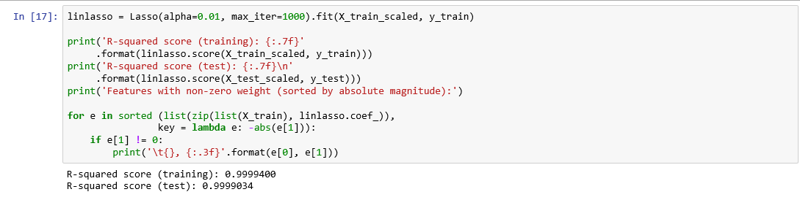
4. Lasso Regression
Next, we try Lasso with alpha of 0.01 to start with and we can see that this does a pretty good job and gives similar result to Linear Regression

Slide 21
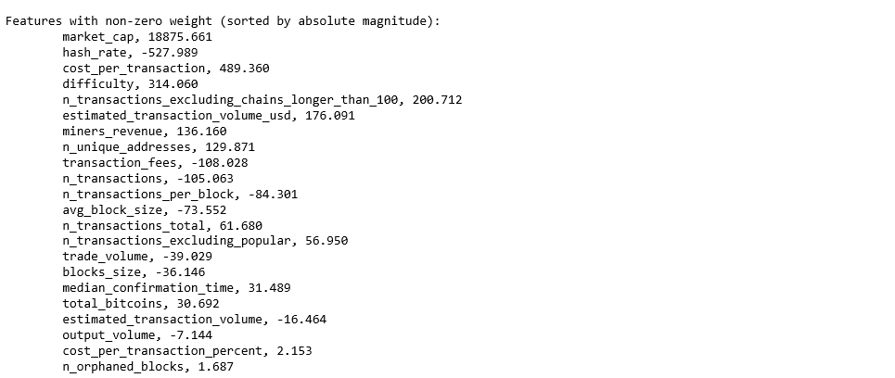
Lasso Regression Output

Slide 22
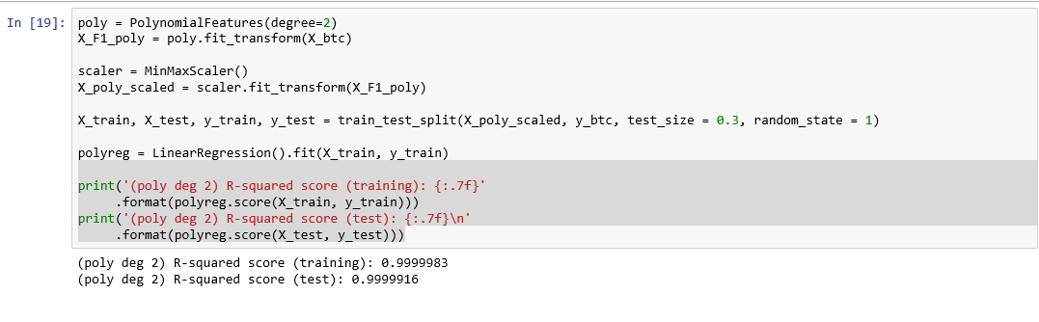
5. Polynomial Regression
We try polynomial regression because a lot of variables seem to have a non-linear trend and kind of parabolic trend
Performance is better than linear regression with a better accuracy on both train and test set

Slide 23
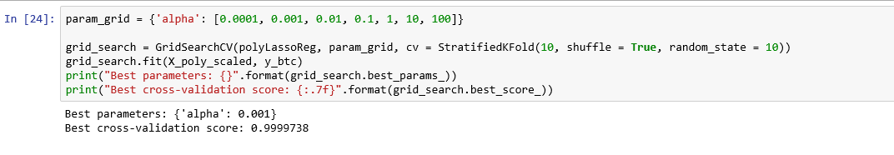
Grid Search
As with polynomial we will use a lot of features and Lasso is giving the same result
Thus, we will use the Polynomial Lasso regression with alpha of 0.0012 to predict the values for the final test set.

Slide 24
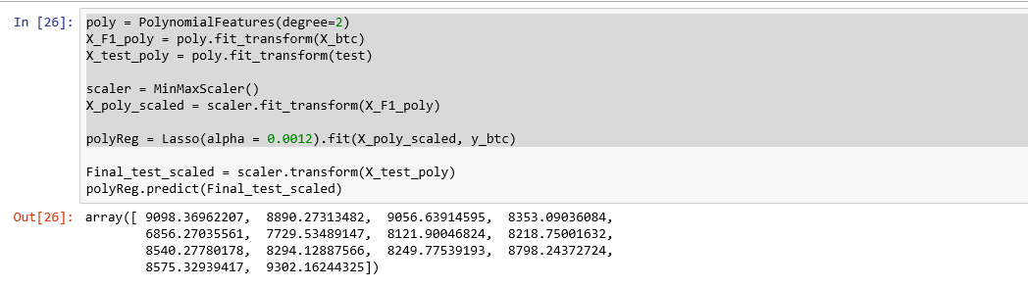
Best Predictor Model:
Polynomial Lasso regression with alpha of 0.0012

Slide 25
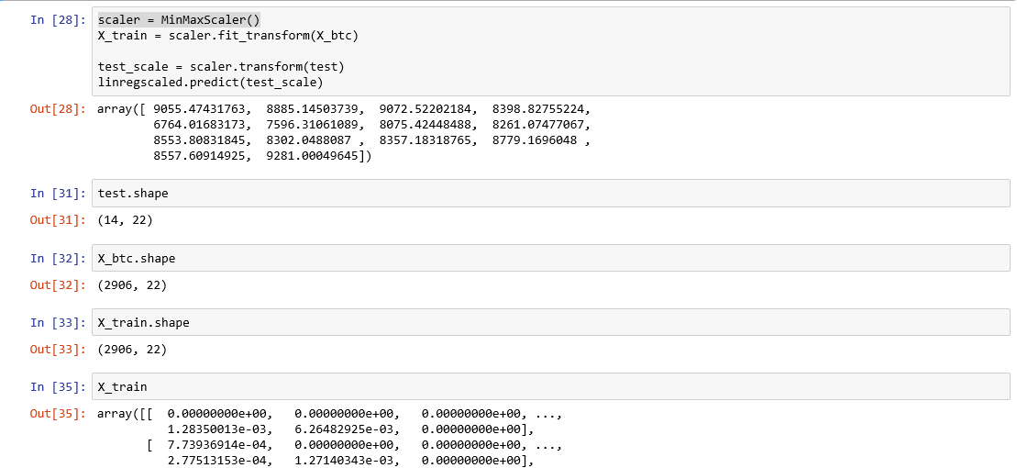
We are also putting results for Linear Regression so we can also consider those values for better decision making

Slide 26
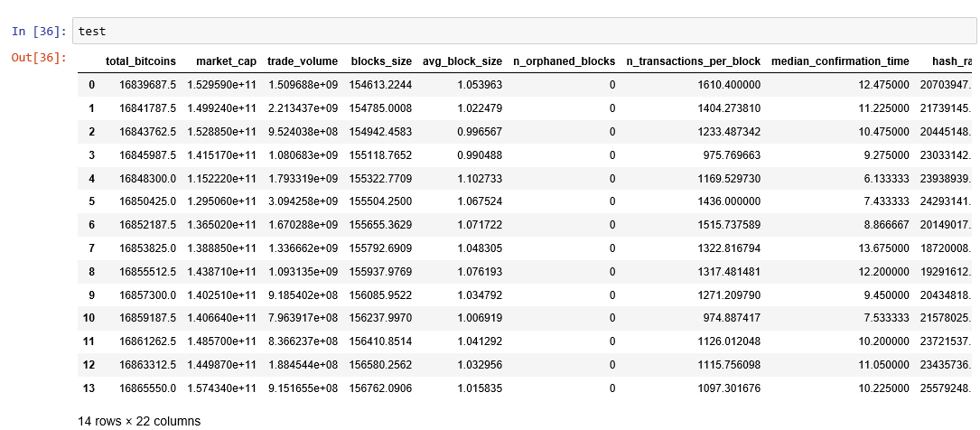

Slide 27
References
Kaggle Dataset
https://en.wikipedia.org/wiki/Bitcoin
https://www.lifewire.com/what-are-bitcoins-2483146

Slide 28
THANK YOU

